Slide 1


JAVA VIRTUAL INTERNSHIP
This presentation will guide you through the process of becoming a virtual intern in the field of Java programming.
You'll learn about the program structure, the skills you will acquire, and the projects you'll work on.

Slide 2

Introduction
Overview: Welcome to the Java Virtual Internship at Company/Institution. This program is designed to equip you with essential Java skills through hands-on projects and guided learning.
Objectives: The primary goal is to develop proficiency in Java programming, build real-world applications, and gain valuable experience in software development.
Structure: This internship is structured around three project levels: Basic, Intermediate, and Advanced. You'll start with foundational projects and gradually progress to more complex challenges.

Slide 3

Learning Modules and Curriculum
This internship program offers a comprehensive curriculum designed to equip you with the essential skills and knowledge to succeed in the world of Java programming. We have carefully crafted the modules to provide a structured learning experience that covers both theoretical concepts and practical application.
The curriculum is divided into various modules, each focusing on a specific aspect of Java programming. We begin with the fundamentals, such as data types, variables, operators, and control flow. As you progress, you'll delve into object-oriented programming principles, advanced data structures, algorithms, and other essential concepts.

Slide 4
Technologies Used
Java
Tools & Frameworks
This internship will leverage the power of Java, a widely used and versatile programming language. You'll learn to write robust and efficient code, taking advantage of Java's rich libraries and object-oriented features. The internship will guide you through the core concepts of Java, preparing you to build complex applications.
You'll gain experience with common development tools like Maven or Gradle for dependency management and project build automation. You'll explore frameworks that enhance the development process, such as Spring Boot, a popular framework for building web applications.

Slide 5




Installation and Usage
Prerequisites
Step-by-step setup guide
How to run the project
Key usage scenarios
Before you can run the Java Virtual Internship project, you'll need to have a few essential tools installed. The first is Java Development Kit (JDK). Ensure you have a compatible version installed on your system. You also need an integrated development environment (IDE), such as IntelliJ IDEA, Eclipse, or NetBeans. Choose your preferred IDE and download it from its official website.
Once you have the prerequisites installed, you can proceed with the step-by-step setup guide. Download the project files from the provided repository. Open the project in your chosen IDE. You might need to configure the IDE to work with Java projects. After setting up the IDE, you can compile and run the code to explore the functionalities.
To run the project, navigate to the main class file in your IDE. You can use the IDE's built-in run configurations to execute the code. This will compile the Java code and start the application, displaying the desired output. You can test different parts of the code or interact with the application through the user interface.
The project offers various usage scenarios, allowing you to experiment with Java and explore its capabilities. You can use the tasks to learn about core programming concepts like data structures, algorithms, and object-oriented programming. Additionally, you can leverage the Java Virtual Internship to strengthen your problem-solving skills and gain practical experience in building real-world applications.

Slide 6

Basic Project
We'll start with a basic project that you can use as a foundation for the following exercises and larger projects. This project is designed to introduce you to the fundamental concepts of Java and the Java Virtual Machine.
You will learn how to create a simple Java program, compile it using the Java compiler, and run it on your computer. We will also cover basic Java syntax, such as data types, variables, operators, and control flow. This project is intended to be a starting point for your journey to become a proficient Java developer. You will find that it is a stepping stone towards tackling the more complex projects that lie ahead.

Slide 7
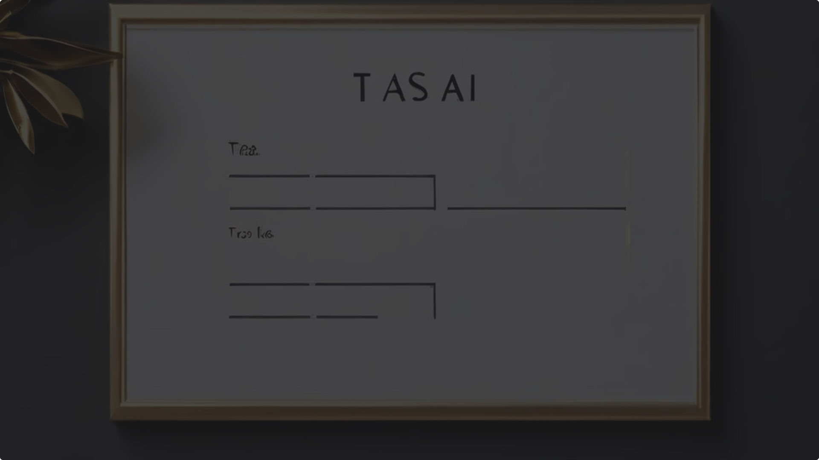
Task 1: Simple Task List Application
This task will guide you through the process of building a straightforward task list application. You'll learn about fundamental Java concepts, such as input/output, data structures, and basic program flow. This practical exercise will enable you to create a functional application that allows users to manage their daily tasks efficiently.
The application will feature a simple text-based interface, where users can interact with the program by entering commands. You'll implement functionalities to add, remove, and list tasks. As you work through this task, you'll develop a solid understanding of Java's core principles and build the foundation for more complex projects.

Slide 8

Task 2: Password Generator using Java
In this task, you'll learn how to create a password generator application using Java. You'll explore various aspects of password security, including generating strong passwords, incorporating special characters, and understanding password complexity. You'll also learn about best practices for storing passwords securely, including hashing and salting techniques.
You'll be creating a Java program that takes user input for desired password length and complexity level. The program will then generate a random password that meets the user's specifications. This task emphasizes building a practical and secure solution for password generation, enhancing your understanding of cryptography and security principles in Java.

Slide 9


Task 3: Snake Game using Java
In our childhood, nearly all of us enjoyed playing classic snake games. Now we will try to enhance it with the help of Java concepts. The concept appears to be easy, but it is not that effortless to implement.
This task will allow us to develop and implement a basic Snake game. We will learn to implement game logic, handle user input, and create a basic graphical interface. This project will challenge us to apply our knowledge of Java concepts, such as object-oriented programming and basic GUI design, and provide us with the opportunity to improve our problem-solving skills.

Slide 10

INTERMEDIAE Project
This project will allow you to apply your Java skills and knowledge to a more complex and challenging task. You will be tasked with developing a full-fledged application, requiring you to plan, design, and implement the functionality efficiently. This experience will further solidify your understanding of Java concepts and software development best practices.
Throughout this project, you'll encounter various challenges that will test your problem-solving abilities and creativity. You'll also have the opportunity to explore different design patterns and coding techniques, which will enhance your overall Java development proficiency. Don't be afraid to experiment and push your boundaries during this phase.

Slide 11
Task 1: Employee Management Application
The Employee Management Application, a robust Java-based software, streamlines the process of managing employee information. This application provides an intuitive interface for Human Resource departments and managers, enabling them to efficiently add, view, update, and delete employee records. It serves as a centralized platform for managing employee data, including personal details, contact information, employment history, performance reviews, and payroll information.
1
Data Security
2
User-Friendly Interface
The application prioritizes data security by implementing robust authentication and authorization measures. It safeguards sensitive employee data using encryption techniques and access control mechanisms.
The application features a user-friendly interface designed for ease of navigation and interaction. It incorporates intuitive menus, clear labels, and helpful tooltips to ensure a seamless user experience.
3
Report Generation
4
Integration Capabilities
The Employee Management Application facilitates the generation of detailed reports on employee data, providing valuable insights into workforce demographics, performance trends, and compensation analysis.
It seamlessly integrates with other HR systems, such as payroll and benefits platforms, to streamline processes and eliminate redundant data entry.

Slide 12
Task 2: Web Medical Management System
Virtual Medicine Home, a comprehensive web-based medical management system built with Java, empowers patients, doctors, and organ donors to connect and manage their medical needs efficiently. This platform offers a user-friendly interface, simplifying the process of scheduling appointments, managing patient records, and facilitating connections with potential organ and blood donors. Its two key modules - Admin and Doctor - cater to different user needs.
Admin Module
Doctor Module
Patient Module
The Admin module serves as the central control panel for managing the system. It allows administrators to control user access, monitor system performance, and manage system configurations. Additionally, it enables administrators to add, update, and delete doctors and patients, ensuring a secure and controlled environment.
The Doctor module provides doctors with a secure platform to access patient records, schedule appointments, and manage their patient load effectively. It allows doctors to communicate with patients through the system, providing seamless communication and follow-up care. The Doctor module is designed to enhance the efficiency of medical practice and improve patient care.
The Patient Module empowers patients to manage their health information, schedule appointments with doctors, and access their medical records securely. The system also provides patients with convenient access to information about available organ and blood donors, fostering a sense of community and support within the platform.

Slide 13




ADVANCED Project: Web-Based Airline Reservation System
The Advanced Web-Based Airline Reservation System, a sophisticated Java-based application, provides a user-friendly platform for booking and managing airline tickets online. It leverages a web-based interface to offer a wide range of features, catering to both individual travelers and airline management needs.
Flight Search
Seat Selection
Booking Management
Admin Controls
The system enables users to search for flights based on various criteria, including departure and arrival cities, dates, airlines, and price range. It displays a list of available flights, providing flight details, pricing, and seat availability.
Once a flight is selected, users can choose their preferred seats. The system visually represents the seating layout, allowing users to select seats according to their needs and preferences.
The system offers comprehensive admin controls for managing flight information, including flight addition/removal, schedule adjustments, and fare updates. These features empower airlines to maintain accurate and up-to-date flight data.
The system securely manages booking information, allowing users to view, modify, and cancel bookings as needed. It also provides users with confirmation emails and real-time updates on their booking status.

Slide 14
Overall Learning and Achievements
The Java Virtual Internship provided a valuable learning experience, equipping me with a comprehensive understanding of Java programming and its applications in building web-based applications. This internship journey honed my skills in software development, problem-solving, and team collaboration. It also fostered my ability to learn and adapt quickly to new technologies and challenges.
Skills Acquired
Achievements
Java Programming Fundamentals
Successfully developed and deployed three web-based applications
Object-Oriented Programming Principles
Demonstrated strong problem-solving and analytical skills
Web Development Technologies (HTML, CSS, JavaScript)
Successfully collaborated with team members on project tasks
Database Management (SQL)
Developed a deep understanding of software development methodologies

Slide 15



Conclusion
The Java Virtual Internship has been an enriching experience, providing a solid foundation in Java programming and web development. The projects undertaken during the internship have instilled valuable technical skills and a strong understanding of software development principles. The knowledge gained through this internship serves as a stepping stone for my future career in software engineering.
Boost
Enhanced Learning
Networking Opportunities
This internship has significantly boosted my confidence in my technical abilities and provided me with a competitive edge in the job market.
The internship has enhanced my learning capabilities and exposed me to industry-standard practices, preparing me for real-world challenges.
The internship provided opportunities to connect with industry professionals and gain insights into the software development landscape.

Slide 16
Thank You
Thank you to the Java Virtual Internship program for providing this invaluable learning experience. I am grateful for the opportunity to have gained valuable skills and knowledge, which will undoubtedly contribute to my future success in the field of software development.
P NAGA CHIRUDEEP
INTERN ID:SMI66210

